Slide 1
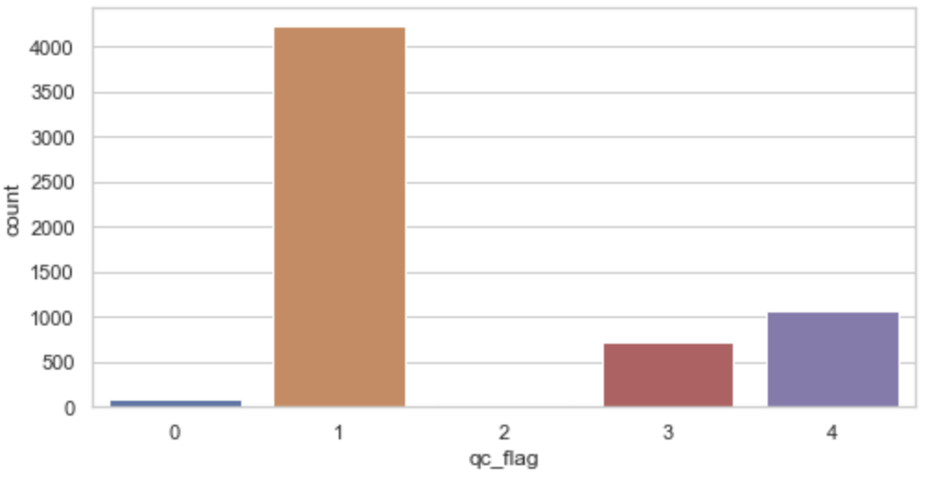
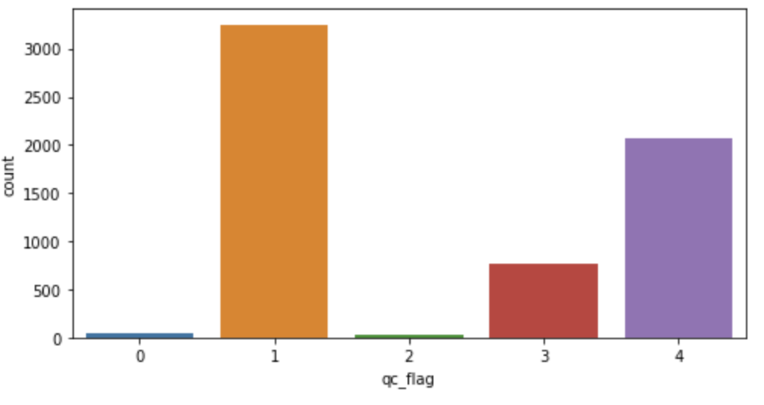
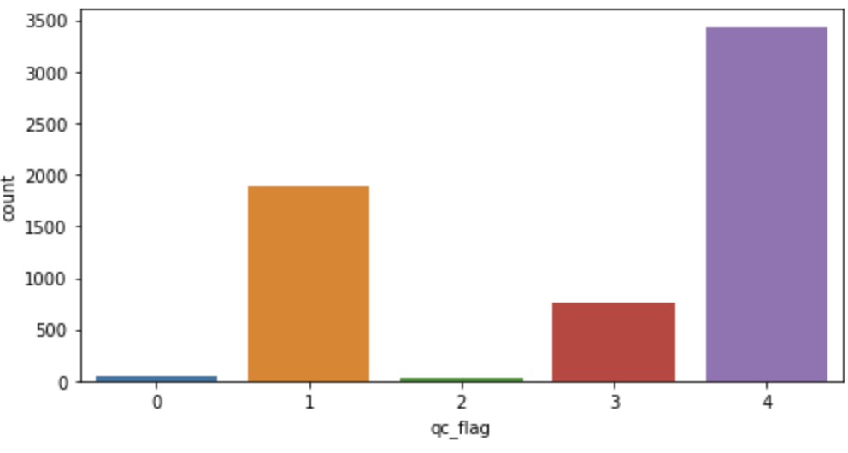
Old_phase_I_II
Criteria_1 (many qc=0,1)
qc=0: 97
qc=1: 4,225
qc=2: 33
qc=3: 724
qc=4: 1,077
Criteria_2 (less qc=0,1)
qc=0: 42
qc=1: 3,250
qc=2: 34
qc=3: 760
qc=4: 2,070
Criteria_3 (do not use avg)
qc=0: 42
qc=1: 1,890
qc=2: 34
qc=3: 759
qc=4: 3,432

Slide 2
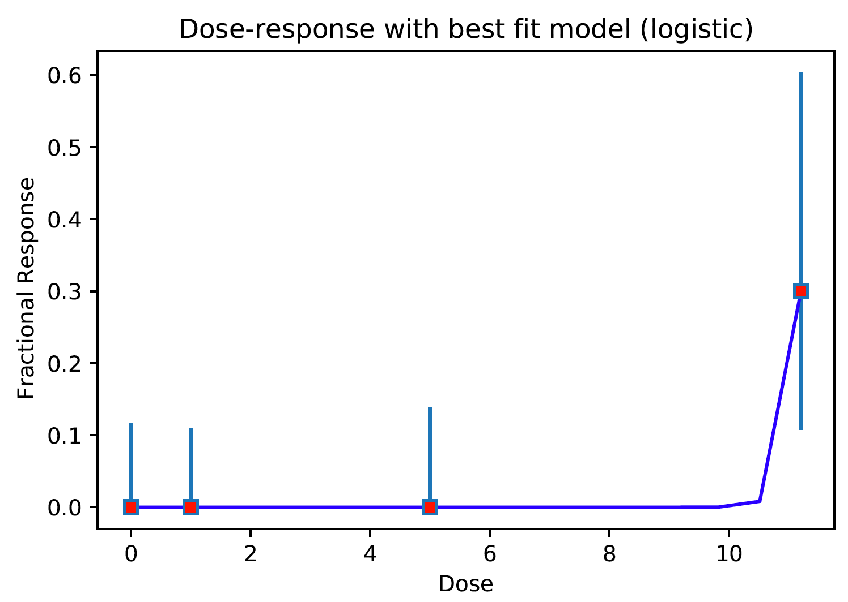
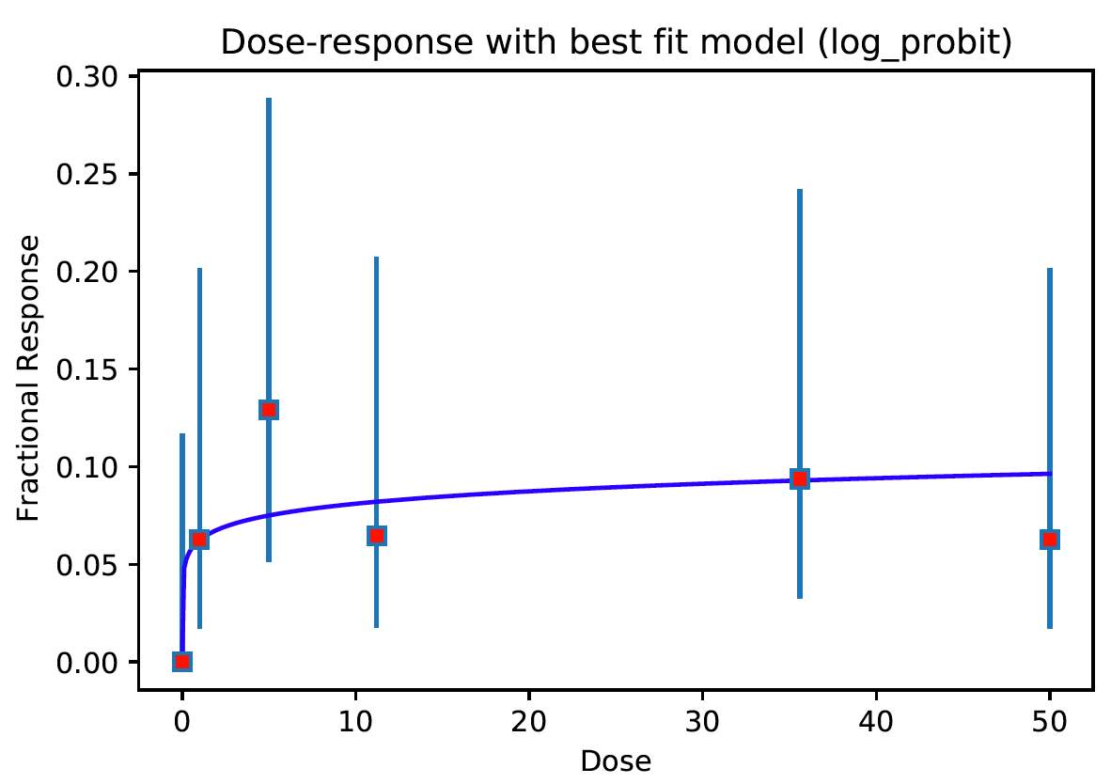
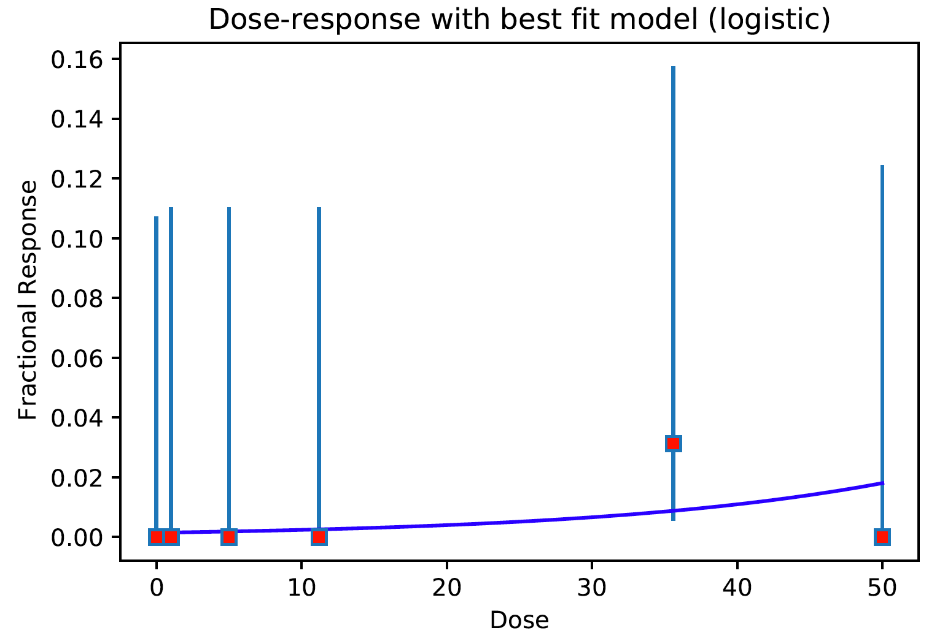
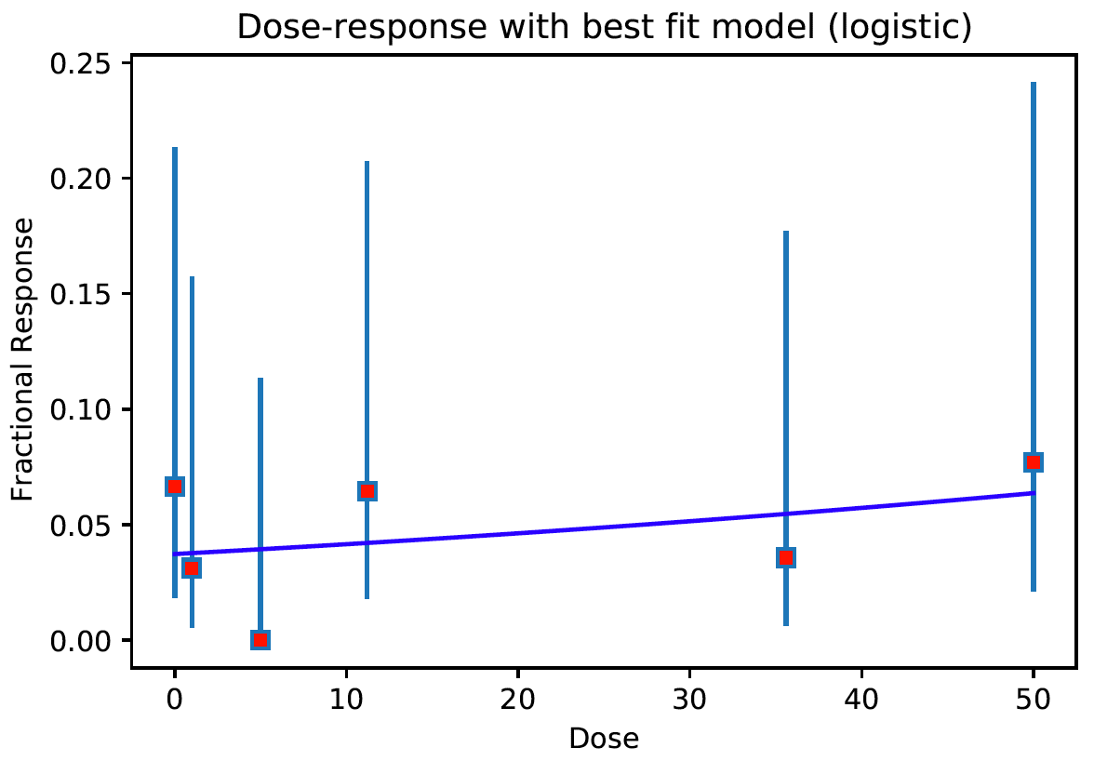
qc=1 (Oldest_criteria), qc=4 (Newer_criteria (less qc=0,1))
old_phase_I_II

Slide 3
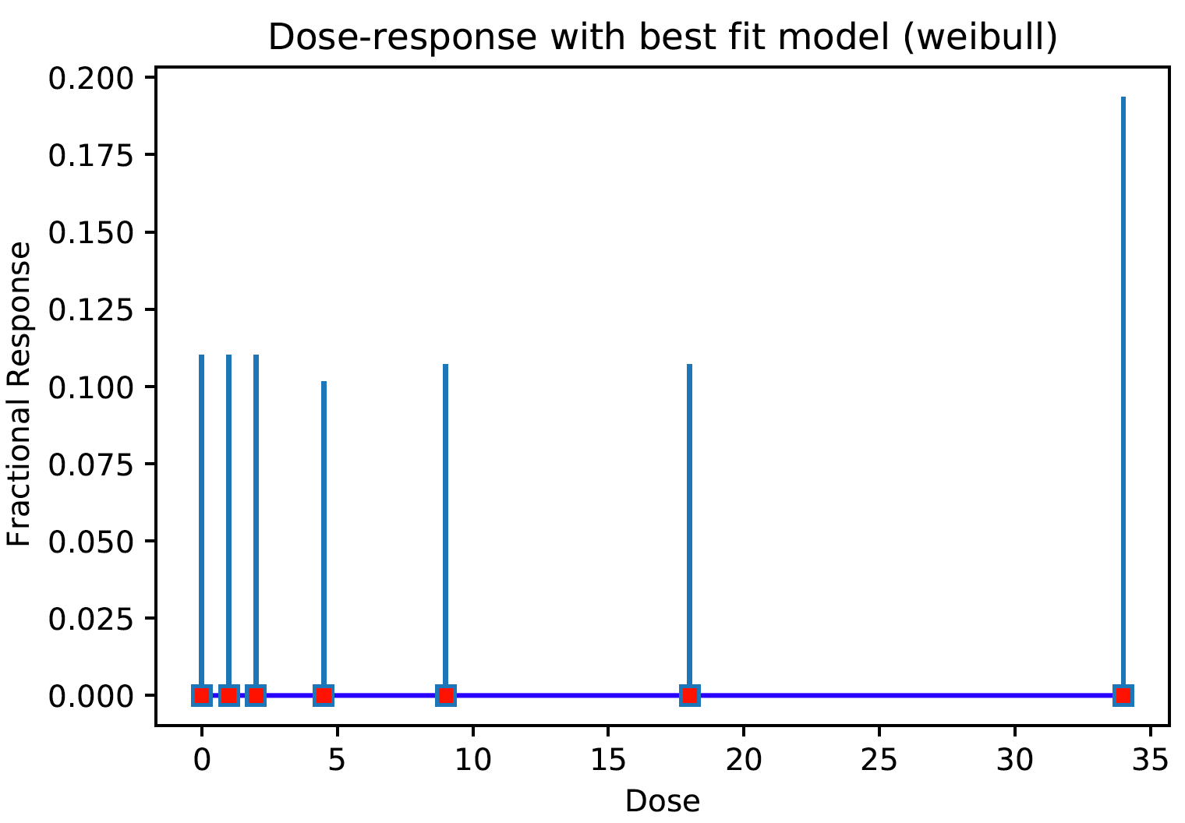
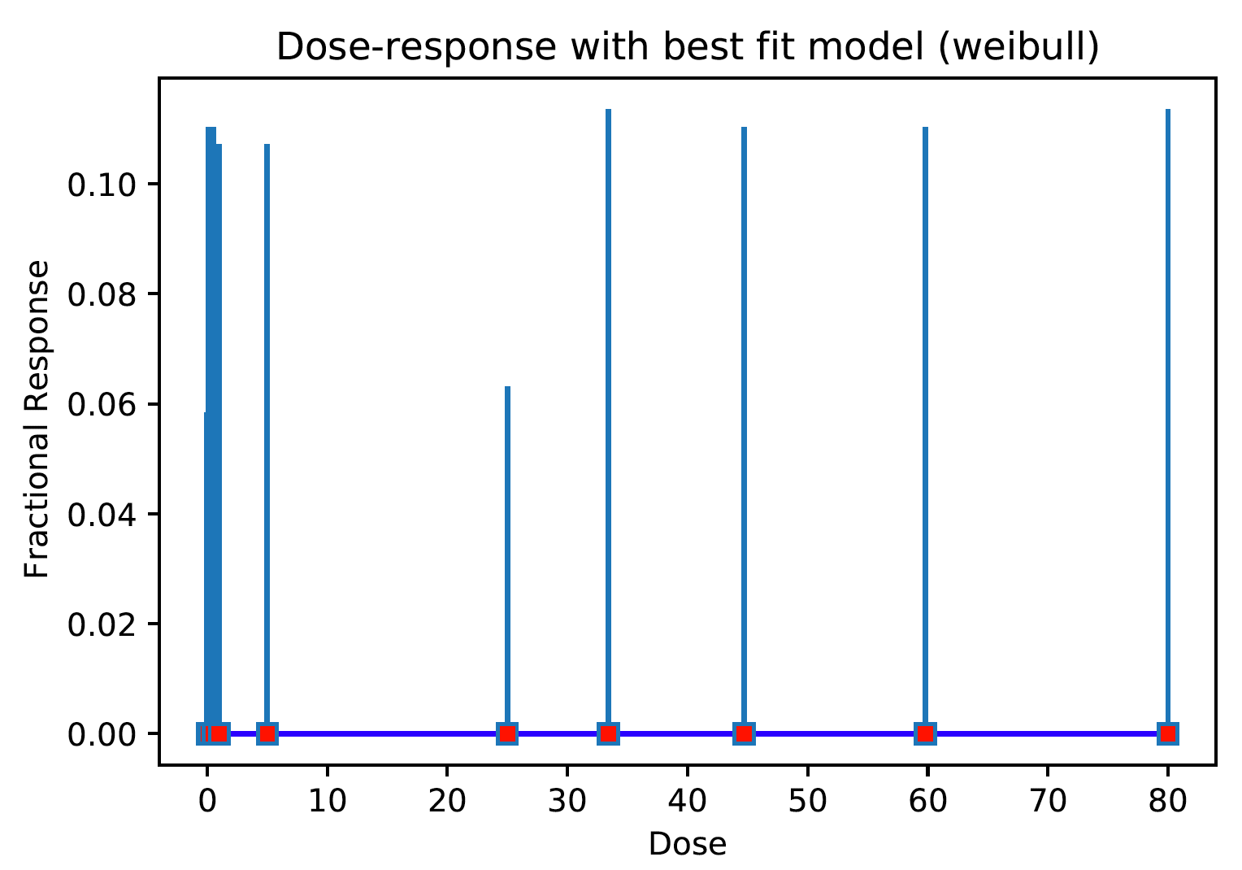
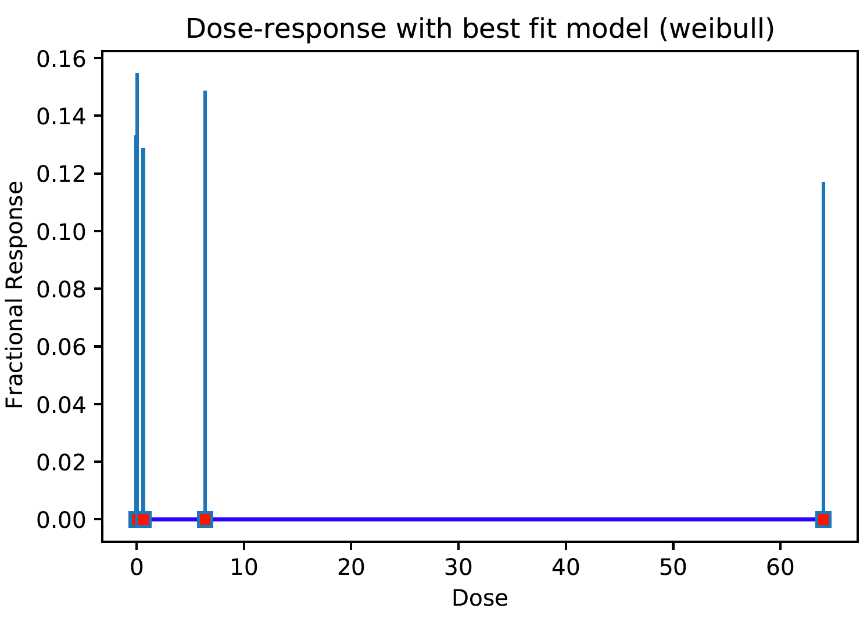
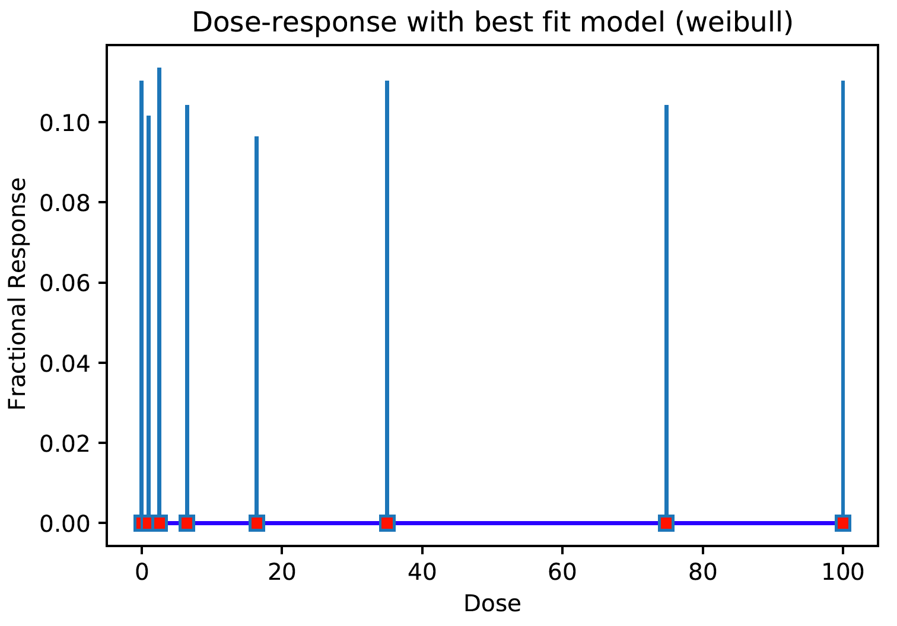
qc=1 (Newer_criteria (less qc=0,1)), qc=4 (newest_criteria (do not use avg))
1770_DP24
Chemical_ID | End_Point | Dose | Response | CI_Lo | CI_Hi
1670 | NC__ | 0 | 0 | 3.47E-18 | 0.05834407
1670 | NC__ | 0.1 | 0 | 0 | 0.1102554
1670 | NC__ | 0.5 | 0 | 0 | 0.1102554
1670 | NC__ | 1 | 0 | 0 | 0.1071792
1670 | NC__ | 5 | 0 | 0 | 0.1071792
1670 | NC__ | 25 | 0 | 0 | 0.06313883
1670 | NC__ | 33.4 | 0 | 0 | 0.11351339
1670 | NC__ | 44.7 | 0 | 0 | 0.1102554
1670 | NC__ | 59.8 | 0 | 0 | 0.1102554
1670 | NC__ | 80 | 0 | 0 | 0.11351339
1670_NC__
1809_BRN_
if (data_corr[0] < 0.2):
qc_flag = 1
data_corr:SpearmanrResult(correlation=nan, pvalue=nan)
3760_DP24
old_phase_I_II

Slide 4
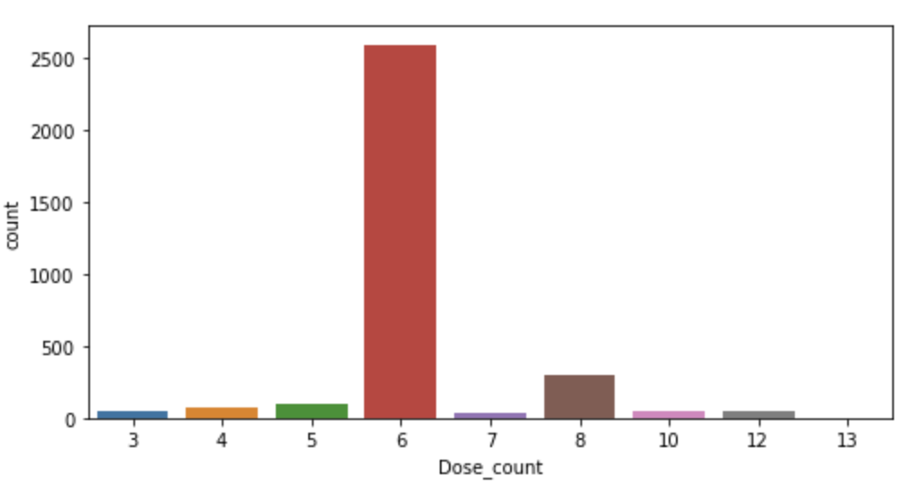
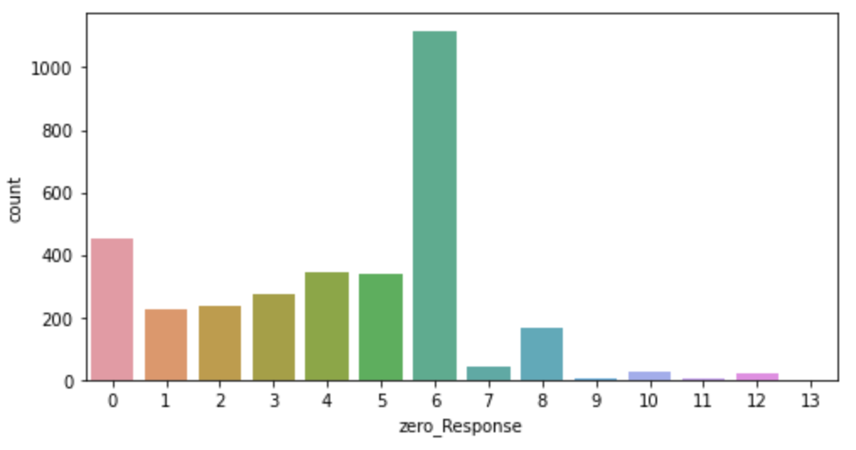
(deprecated) Many 0 responses (Old_phase_I_II)
Most chemical_id_endpoint pairs
have 6 or 8 dose responses
Among these,
many cases have all (“6”) zero responses only
Chemical_ID | End_Point | Dose | Response
53 | NC__ | 0 | 0
53 | NC__ | 1 | 0
53 | NC__ | 5 | 0
53 | NC__ | 11.2 | 0
53 | NC__ | 35.6 | 0
53 | NC__ | 50 | 0
For example,

Slide 5
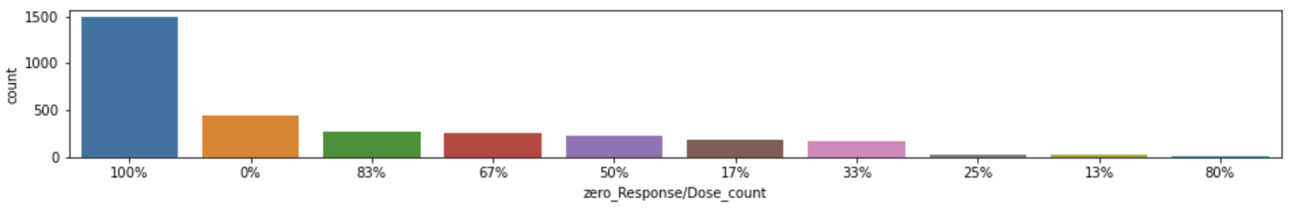
(deprecated) Many 0 responses (Old_phase_I_II)
Indeed, significant portions have
0 responses only
100% responses are zero => 46% (=1492/3249)
0% responses are zero => 14% (=451/3249)
83% responses are zero => 8% (=265/3249)
67% responses are zero => 8% (=255/3249)
# in summary
# 62% data have 0 response >= 67%

